Slide 1
JavaScript Day4
JS
Presented By : Asmaa Ahmed

Slide 2
DOM
Document Object Model: The DOM is a programming interface for HTML and XML documents, representing them as a structured tree of objects. It provides a way to interact with and manipulate the elements and content of a web page dynamically.

Slide 3
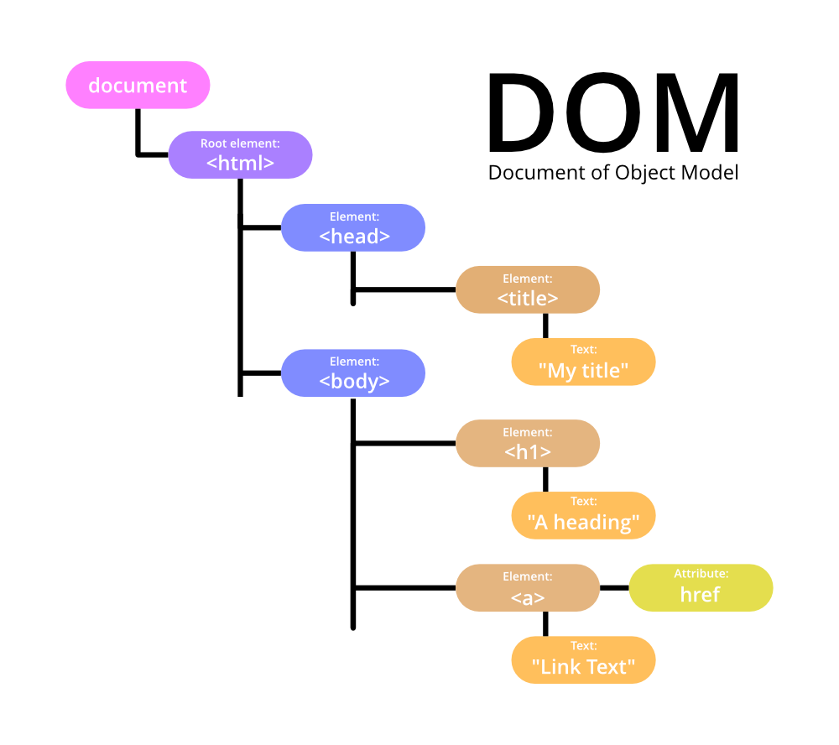
DOM

Slide 4
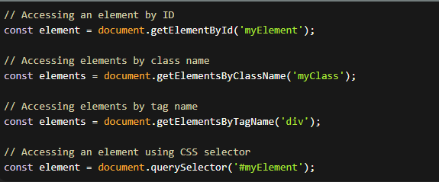
Accessing DOM elements:
You can access DOM elements using various methods, such as getElementById , getElementsByClassName, getElementsByTagName, querySelector, and querySelectorAll.

Slide 5
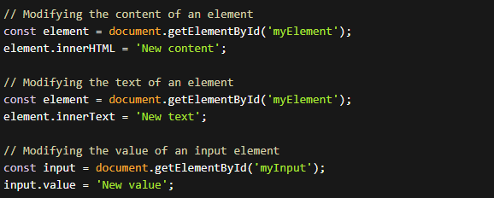
Modifying element properties:
You can modify various properties of DOM elements, such as innerHTML, innerText, textContent, value, src, href, and many more.

Slide 6

Styling elements:
You can manipulate the style of DOM elements using the style property, which allows you to modify CSS properties directly.

Slide 7
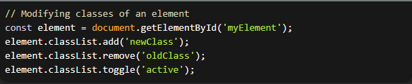
Modifying classes:
You can add, remove, or toggle CSS classes on elements using the classList property and its methods like add, remove, and toggle.

Slide 8
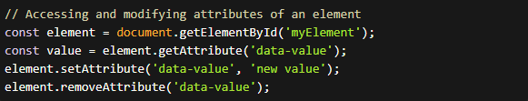
Working with attributes:
You can access and modify attributes of DOM elements using methods like getAttribute, setAttribute, and removeAttribute.

Slide 9


Event handling:
1-click: This event is triggered when an element is clicked.
2-dblclick: This event is triggered when an element is double-clicked.

Slide 10


Event handling:
3-mouseover&mouseout: This event is triggered when the mouse pointer moves over an element.
4- keydown: This event is triggered when a key is pressed down.

Slide 11
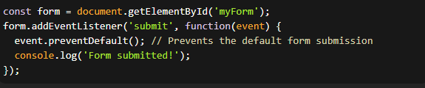
Event handling:
5-keyup: This event is triggered when a key is released.
6- submit: This event is triggered when a form is submitted.

Slide 12
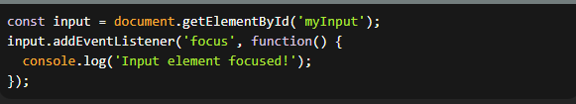

Event handling:
7-focus: This event is triggered when an element receives focus.
8-blur: This event is triggered when an element loses focus.

Slide 13


Event handling:
9-load: This event is triggered when a page or an image finishes loading.
10-scroll: This event is triggered when an element is scrolled.

Slide 14
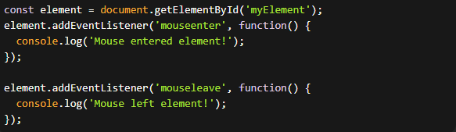
Event handling:
11-mouseenter and mouseleave: These events are triggered when the mouse enters or leaves an element.

Slide 15


Event handling:
12-change: This event is triggered when the value of a form element (like <input>, <select>, or <textarea>) changes and loses focus.
13-keypress: This event is triggered when a key is pressed down and released.

Slide 16
Event Property
events are objects that represent occurrences or interactions within the browser or web page. These event objects contain useful information and properties related to the event that occurred. Here are some commonly used properties of event objects

Slide 17

Event Property
1-event.target:
This property refers to the element on which the event was originally triggered. It allows you to access and interact with the specific element that triggered the event.

Slide 18

Event Property
2-event.type:
This property represents the type of event that occurred. It provides information about the specific event that was triggered.

Slide 19
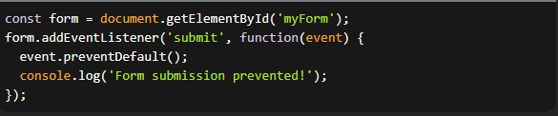
Event Property
3-event.preventDefault():
This method can be called on the event object to prevent the default behavior associated with the event. For example, calling event.preventDefault() in a form submission event handler prevents the form from being submitted and the page from refreshing.

Slide 20

Event Property
4-event.key:
This property holds the value of the key that was involved in a keyboard-related event. It is commonly used in events like keydown, keyup, and keypress.

Slide 21
Thanks!
Do you have any questions?
asmaaahmed23762@gmail.com

